Slide 1
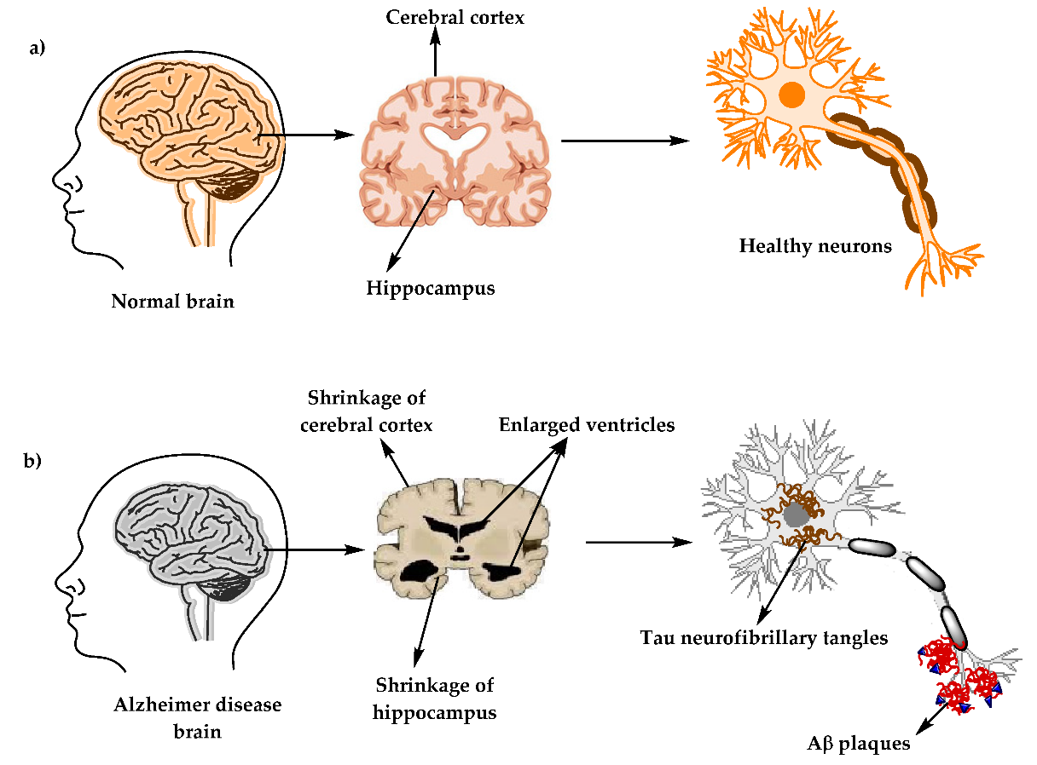
an Alzheimer’s affected brain

Slide 2
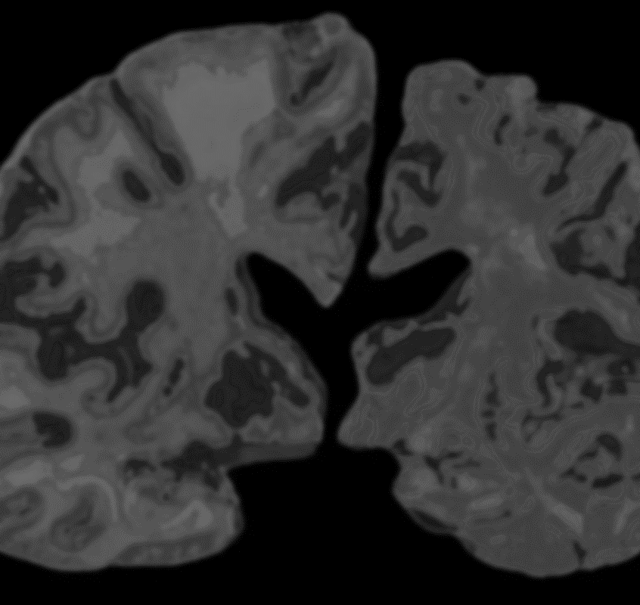
Magnetic resonance imaging
2
+
AND MEDICAL IMAGING TECHNIQUES
Magnetic resonance imaging (MRI) is a medical imaging technique that uses a magnetic field and computer-generated radio waves to create detailed images of the organs and tissues in your body.
Most MRI machines are large, tube-shaped magnets. When you lie inside an MRI machine, the magnetic field temporarily realigns water molecules in your body. Radio waves cause these aligned atoms to produce faint signals, which are used to create cross-sectional MRI images — like slices in a loaf of bread.
A functional MRI of the brain (fMRI) produces images of blood flow to certain areas of the brain and can be used to assess damage from a head injury or from disorders such as Alzheimer's disease.

Slide 3
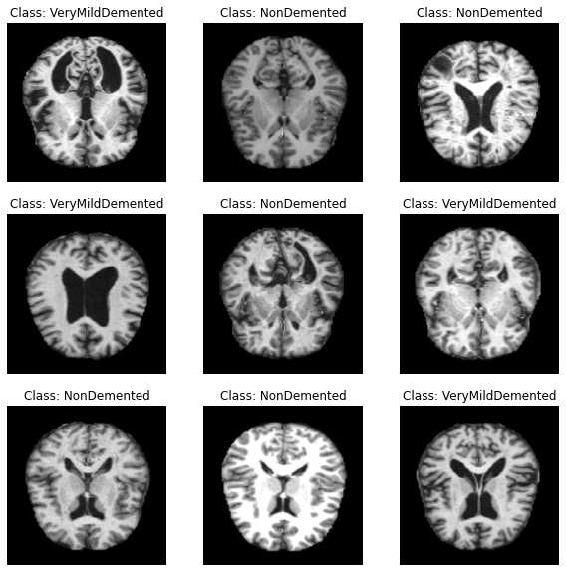
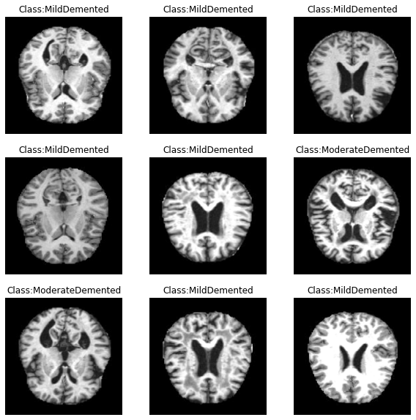
Functional mri (fmri) samples

Slide 4
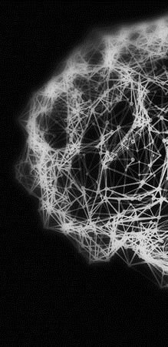
PROJECT ABSTRACT
PROJECT MODULES
This project (named BRAIN.MRI) is an implementation of an Alzheimer’s Detection System. This means that upon being provided the MRI of the patient’s Brain, the presence and stage/type of Alzheimer’s can be accurately detected.
This is done using a Deep Learning model that utilizes the power of Convolutional Neural Networks (CNNs).
When validated over 4 classes of Image data, the model gave an accuracy of 98.88%.
The pipeline of the project includes three components:
Data Acquiring and Preprocessing [Python modules Used: ImageDataGenerator (TensorFlow), SMOTE (Imbalanced-Learn)]
Model Training and Evaluation [Python modules Used: TensorFlow, OpenCV, Scikit-Learn, NumPy]
GUI [Technologies Used: Flask (Python), HTML, CSS, Bootstrap, JavaScript]

Slide 5
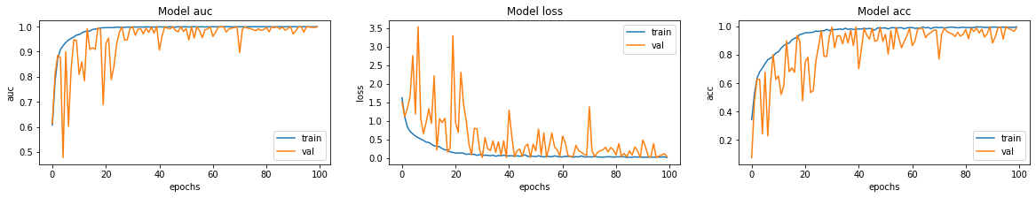

DFD
Model Metrics

